Slide 1
Panel Heating and Cooling (ASHRAE: S6, FACILITY)
Alessandro Eren Boccardo

Slide 2
Problem description
We need to Compute steady state temperature distribution using data from the corresponding project in Applicazioni Avanzate di Fisica Tecnica

Slide 3
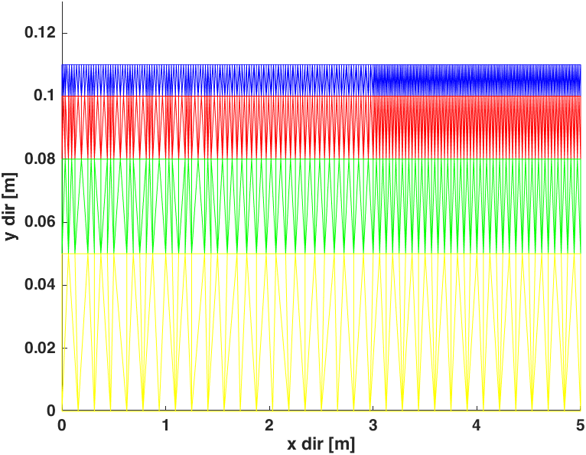
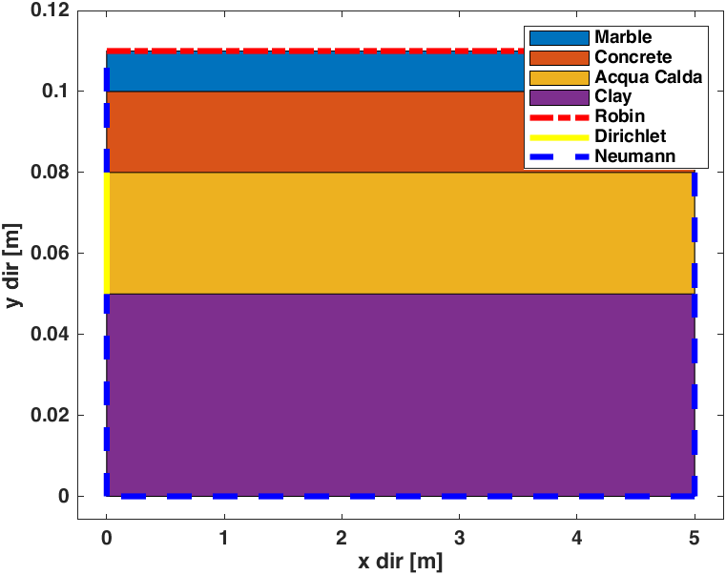
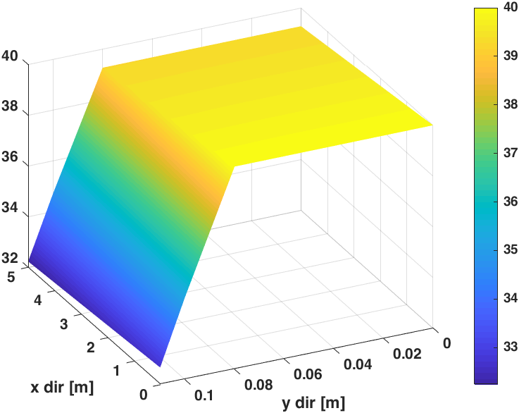
System2

Slide 4
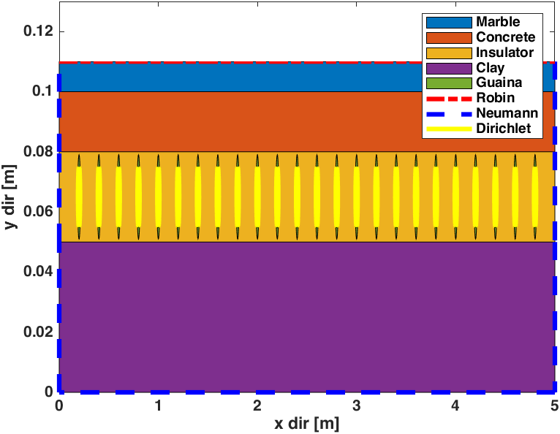
Domain and Boundary conditions

Slide 5
Mesh
The mesh has been refined in the x,y values containing the water flow because we are interested in the temperature distribution in the different layers of the material caused by the flow of hot water(40 C).

Slide 6
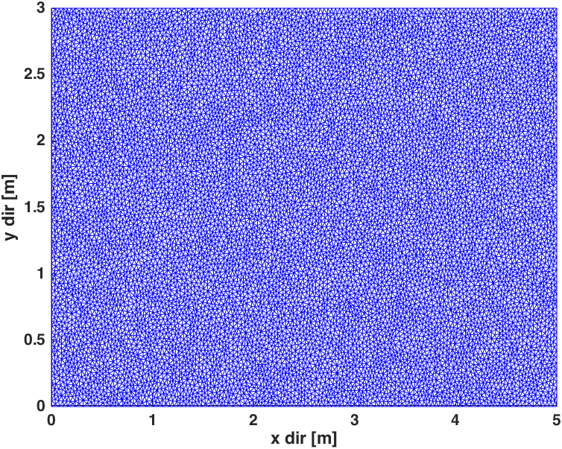
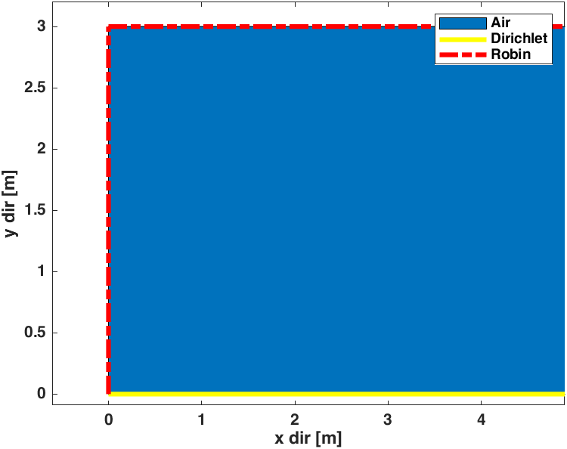
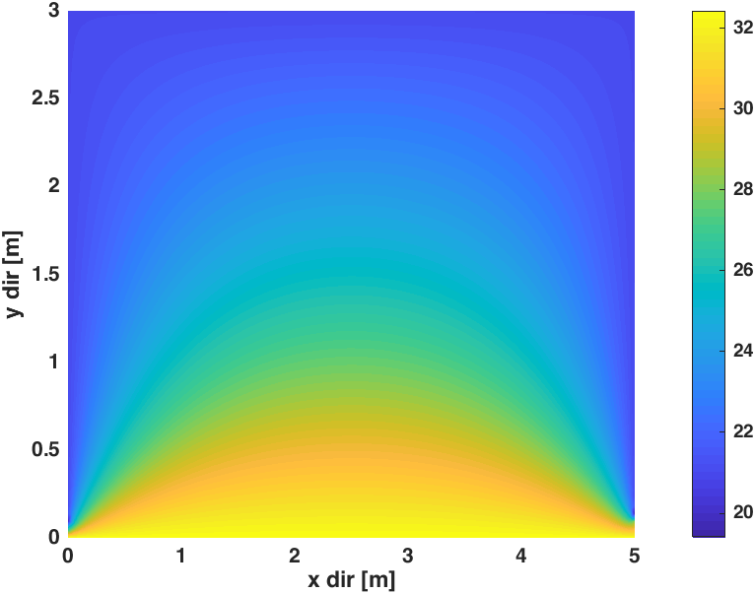
System 1

Slide 7
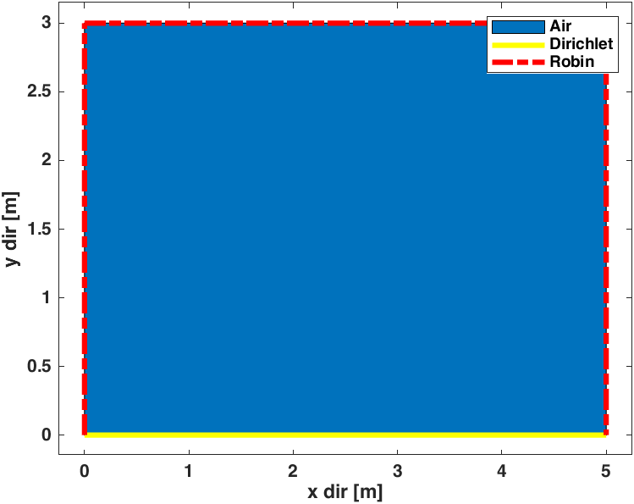
Domain and Boundary conditions

Slide 8
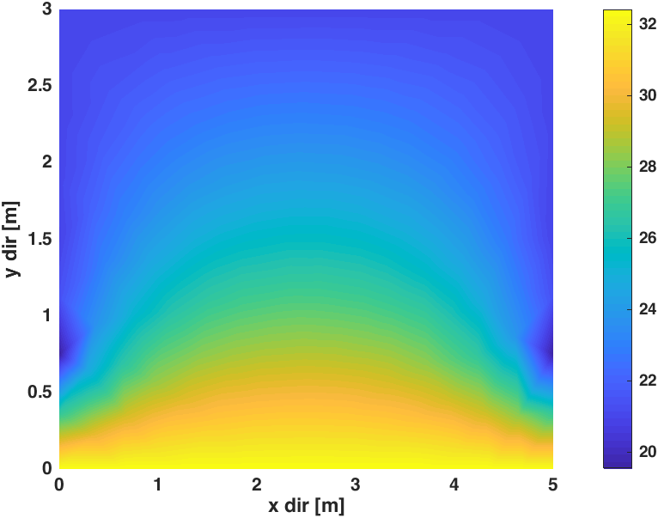
Steady State Solution
Mesh refinement 0.1
Mesh refinement 0.001

Slide 9
Steady state solution
For finding the steady state solution we divided the room in 2 separate systems.One for the heating panel and one for the room containing air.Then we solved system 2(Heating panel) using a 2D numerical method involving the boundary conditions.From the solution of the steady state temperature of system 2 we plug it in system 1 to generate the temperature distribution of the room.

Slide 10
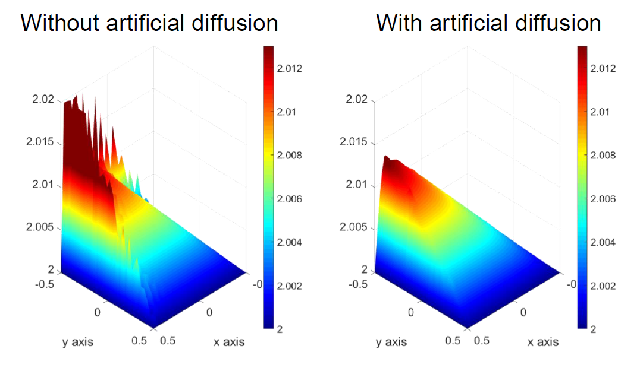
Stedy State Solution

Slide 11
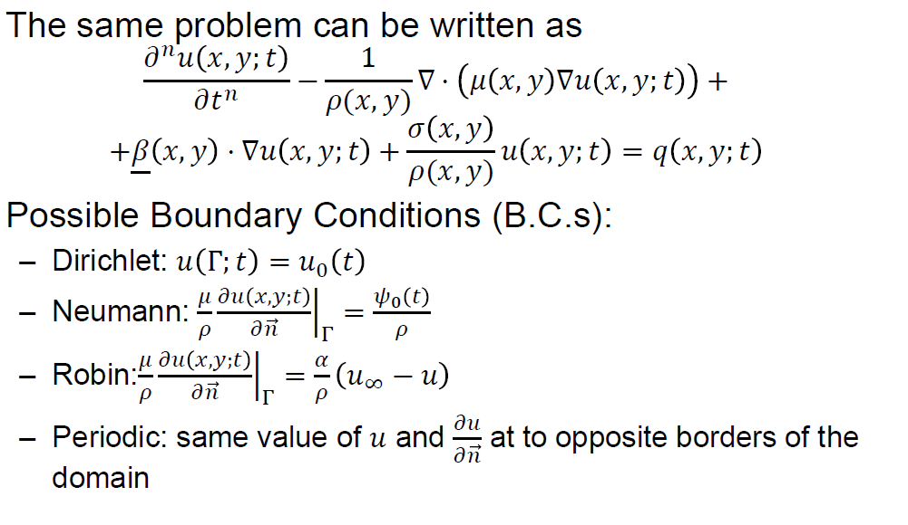
Steady State Solution

Slide 12
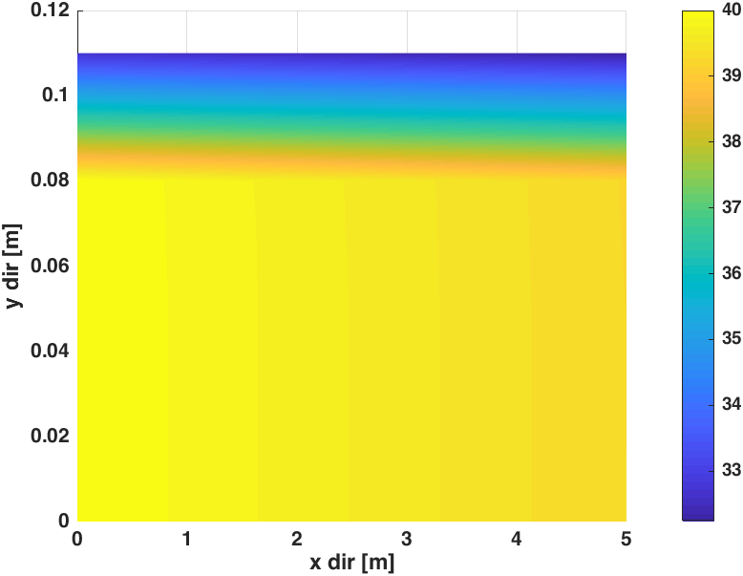
Steady State Solution
The mesh has been refined in the x,y values containing the water flow.

Slide 13
Conclusions
The results show that the heating system with parallel pipes can be an efficient solution for warming up an apartment.
We have a steady state temperature of 35 Degree on the floor.
The solutions show the effects of conductivity and convection in terms of heat lines in the solution.

